Slide 1
Cross-platform Mobile Development on Open Source
John M. Wargo

Slide 2
Abstract
There’s a lot of ways to deliver mobile apps: native, web, commercial mobile app development platforms, and more. In between those options are popular open source projects that provide robust, alternative approaches. In this session, you’ll learn about the venerable Apache Cordova project, the project that defined the hybrid mobile development approach, plus new upstarts like Telerik’s NativeScript, Facebook’s React Native and Microsoft’s Xamarin that take hybrid to the next level, giving developers the ability to create compelling, performant native apps using JavaScript or other languages. Expect a fast-paced, high-energy session with lots of content as John Wargo introduces you to a different way to do mobile using open source tools.

Slide 3

Software Developer, Writer, Presenter, Husband, Father, Geek
Software developer
Former Forrester analyst
Actively seeking full-time employment
Author of 6+1 books
Contributor to the Apache Cordova Project
Doing mostly IoT things lately
Worked at AT&T, BlackBerry, BoxTone, Forrester, SAP

Slide 4









Publications
www.johnwargobooks.com

Slide 5
Agenda
A quick chat about mobile development and mobile development approaches
Defining mobile hybrid development (an introduction to Apache Cordova and perhaps Adobe PhoneGap too)
The problem(s) with hybrid development
The evolution of hybrid development
Open source, cross-platform development (a look at NativeScript, ReactNative, Tabris.js, Titanium, Xamarin)

Slide 6
Mobile Development

Slide 7
Native Mobile Development Is Hard
No common language across popular platforms
No single IDE that can be used for all popular platforms
Hard to be an expert on more than one platform
Requires a Macintosh computer

Slide 8
Mobile Development Is Expensive
Fickle and finicky users drive dev organizations to deliver frequent updates which forces a furious pace of development leading to the requirements for:
Continuous Integration
Automated testing (manual testing can no longer keep up)
Testing that never ends
More to test than just whether the code ‘works’
Device farms

Slide 9
Available Approaches
Web
Native
Hybrid
JavaScript-driven native*
Adjacent native*
Mobile application development platforms
* Terms I coined as an Analyst at Forrester Research

Slide 10
Hybrid Mobile Development

Slide 11


Apache Cordova
An open source framework for building cross-platform mobile applications using

Slide 12
History
Started at the 2008 iPhoneDevCamp by Nitobi
Started with iOS, quickly added Android and BlackBerry support later
In 2011, project was donated to Apache Software Foundation
First as Apache Callback
Then as Apache DeviceReady
Finally as Apache Cordova
Very quickly thereafter (the next day), Nitobi Acquired by Adobe
Expectation that Cordova will become obsolete over time as mobile browsers become more capable*

Slide 13

Contributors
The smartphone industry is heavily involved in the Cordova project
Adobe
Amazon
Google
IBM
Microsoft
Mozilla
Samsung
Ubuntu

Slide 14
Consumers & Supporters
IBM MobileFirst Platform (Formerly IBM WorkLight)
SAP HANA Cloud Platform mobile services (Formerly SAP Mobile Platform)
Oracle Mobile Platform
Salesforce App Cloud
Alpha Software Alpha Anywhere
and many, many, many more!

Slide 15



Apache Cordova
An open source framework for building cross-platform mobile applications using HTML5

Slide 16
WebView
Web application content is rendered within the native application window using a native WebView component
The content is NOT converted in any way
Pretty much allows ANY web content to run (just like a browser)
On older devices, the WebView is not always exactly the same as the browser (for older Android devices, look at the Intel Crosswalk project)
Pluggable WebViews enable you to use whatever one you want

Slide 17
Supported HTML & JavaScript Frameworks
All of them (pretty much)
There are even Hybrid-specific frameworks:
Ionic
Onsen UI
Framework7

Slide 18
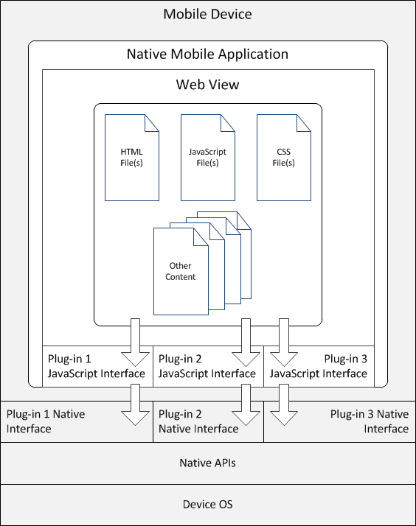
Application Architecture

Slide 19
Tools?
Cordova Command Line Interface (CLI)
Use whatever tools you want to design & code your applications
Use the native SDKs or the PhoneGap Build service to ‘build’ your applications
Can use the CLI with either

Slide 20
Third-party Tools?
Microsoft Visual Studio
Intel XDK
Eclipse THyM
AppGyver, GapDebug, many more
Cordova-aware IDEs: Brackets, Dreamweaver, WebStorm & many more

Slide 21
App Stores
A Cordova application is a Native Mobile application
So, Yes Virginia, Cordova apps can be published in App Stores (even Apple’s)

Slide 22

Adobe PhoneGap
PhoneGap is just a distribution of Cordova, but they are not synonyms
Adobe added on some additional features on top:
PhoneGap Build Service
Hydration
PhoneGap Developer App
PhoneGap Enterprise
Integration with Dreamweaver & other Adobe tools
Commercial Product Support
Which to use: Cordova or PhoneGap (http://www.informit.com/articles/article.aspx?p=2478076)

Slide 23
Anatomy of a Cordova Application

Slide 24
Hello World (Simple)
<!DOCTYPE HTML>
<html>
<head>
<title>Hello World</title>
</head>
<body>
<h1>Hello World</h1>
<p>This is a simple web application</p>
</body>
</html>

Slide 25
Hello World (Interesting)
<!DOCTYPE html>
<html>
<head>
<script type="text/javascript" charset="utf-8"
src="cordova.js"></script>
<script type="text/javascript" charset="utf-8">
function onBodyLoad() {
document.addEventListener("deviceready", onDeviceReady, false);
}
function onDeviceReady() {
navigator.notification.alert("Cordova is ready!");
}
</script>
</head>
<body onload="onBodyLoad()">
<h1>Hello World</h1>
<p>This is a sample Cordova application.</p>
</body>
</html>

Slide 26
The Cordova APIs
Originally custom APIs created by the dev team
Inconsistently implemented across mobile platforms
Migrated (where possible) to implementations of device-specific APIs based on formal standards (WWWC, Device APIs Working Group and so on)
APIs not implemented on platforms where the capability already exists in the browser
APIs removed from a platform when the platform adds the API to the browser
APIs could be maintained after formal standard is abandoned (File API)
Most of the APIs are implemented as plugins (some exist in the core)

Slide 27
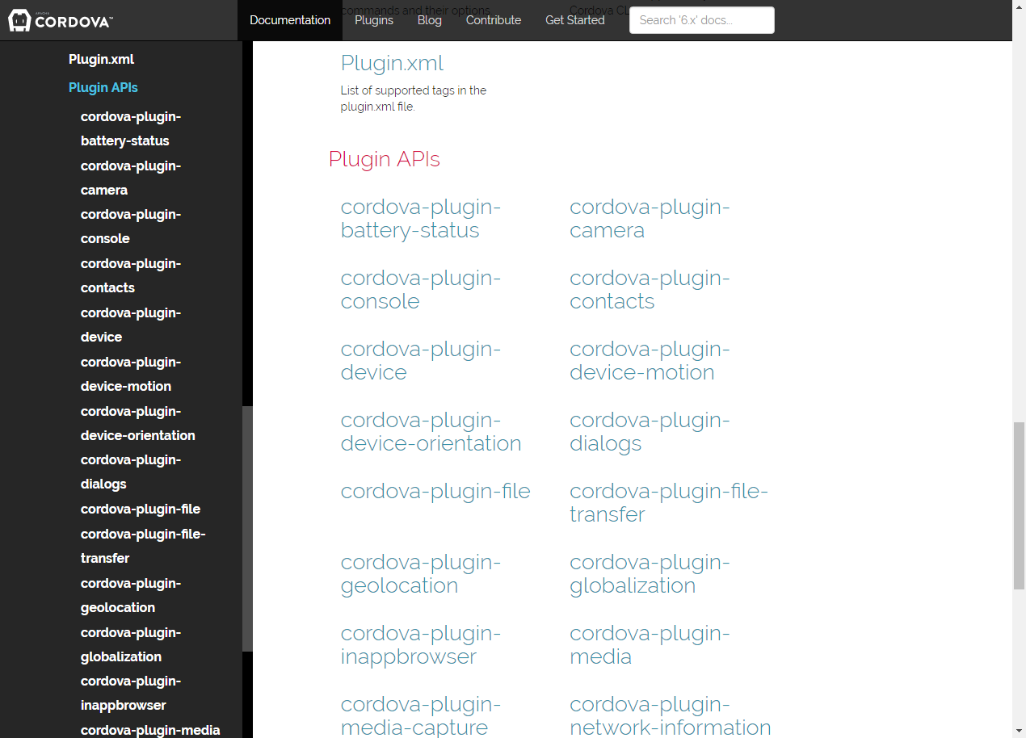

Slide 28
Hello World (Does Something) (Part 1)
<body onload="onBodyLoad()">
<h1>Hello World</h1>
<p>This is a Cordova application that makes calls to the Cordova Device API.</p>
<p id="appInfo">Waiting for Cordova Initialization to complete</p>
</body>

Slide 29
Hello World (Does Something) (Part 2)
function onDeviceReady() {
//HTML break tag
br = "<br />";
//Get the appInfo DOM element
var element = document.getElementById('appInfo');
//replace it with specific information about the device
//running the application
element.innerHTML =
'Cordova Version: ' + device.cordova + br +
'Platform: ' + device.platform + br +
'Model: ' + device.model + br +
'OS Version: ' + device.version;
}

Slide 30
Hello World (Does Something) Example

Slide 31
Using the Camera API
First open a terminal window and add the camera plugin to your Cordova application:
cordova plugin add cordova-plugin-camera
Next add the following line to your web application’s JavaScript code:
navigator.camera.getPicture( successCallback, errorCallback, cameraOptions);
Success and error callback functions deal with results
Camera Options object controls what happens when the picture is taken

Slide 32
Camera Options
Optional parameters to customize the camera settings.
var cameraOptions = {
quality : 75,
destinationType : Camera.DestinationType.DATA_URL,
sourceType : Camera.PictureSourceType.CAMERA,
allowEdit : true,
encodingType: Camera.EncodingType.JPEG,
targetWidth: 100,
targetHeight: 100,
popoverOptions: CameraPopoverOptions,
saveToPhotoAlbum: false
};

Slide 33
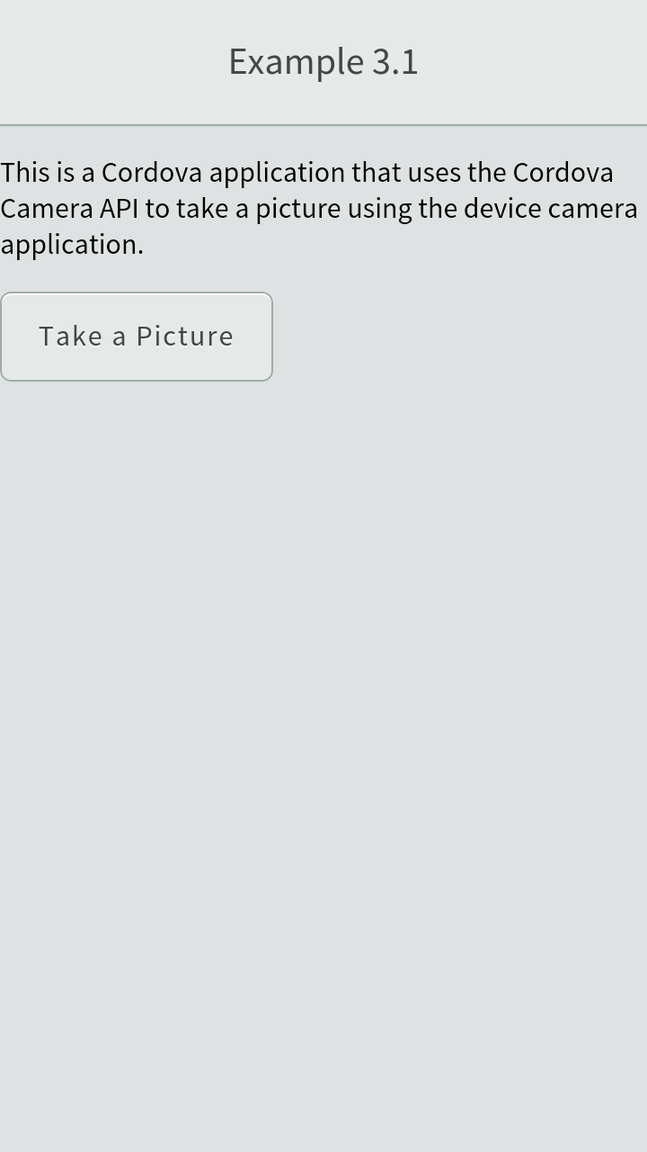

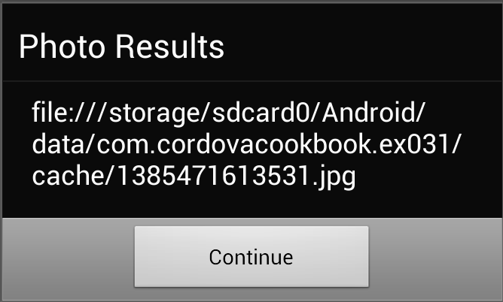
Camera Example

Slide 34

Installation
Configure one or more native development environments
Install NodeJS (http://nodejs.org/)
Open a terminal window and type:
npm install –g cordova

Slide 35
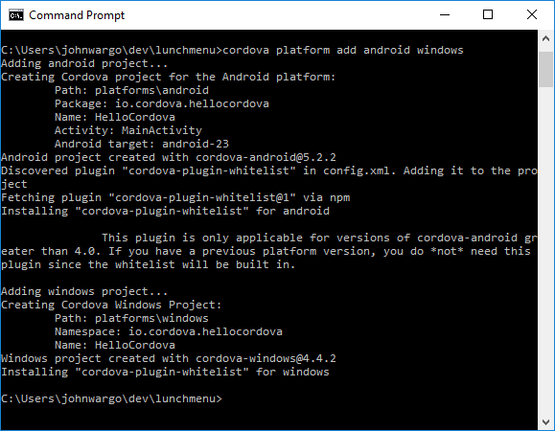
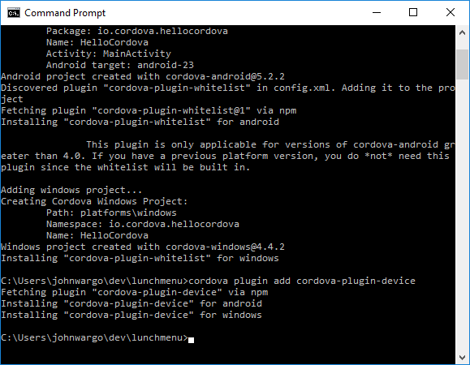
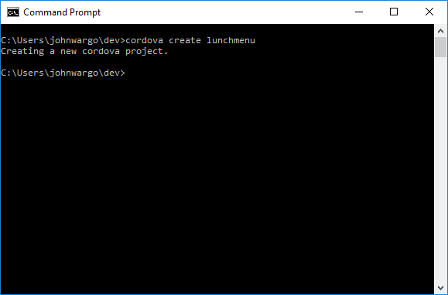
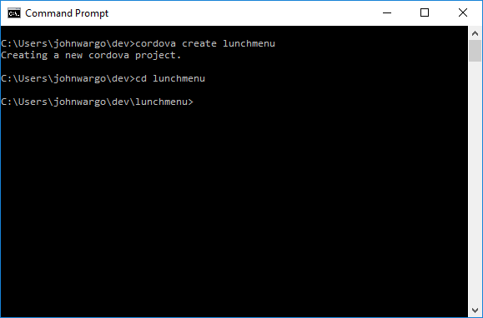
The Cordova CLI

Slide 36
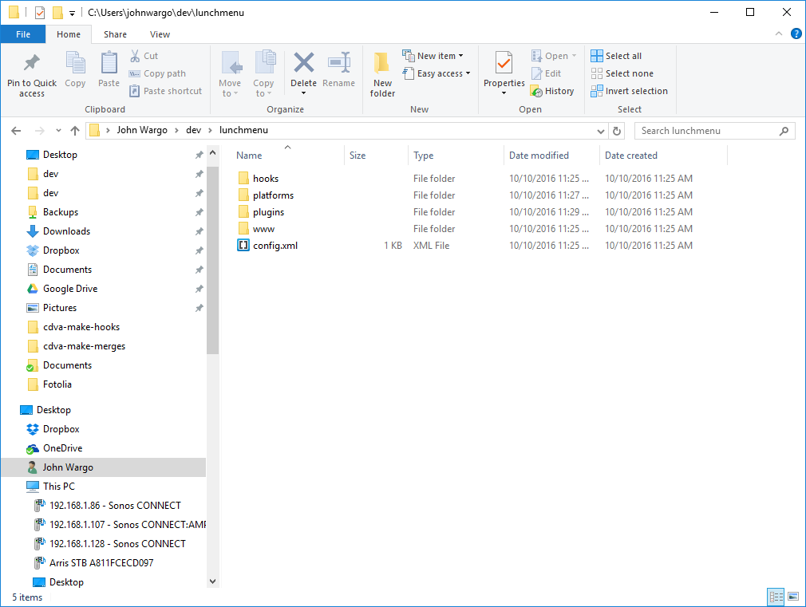
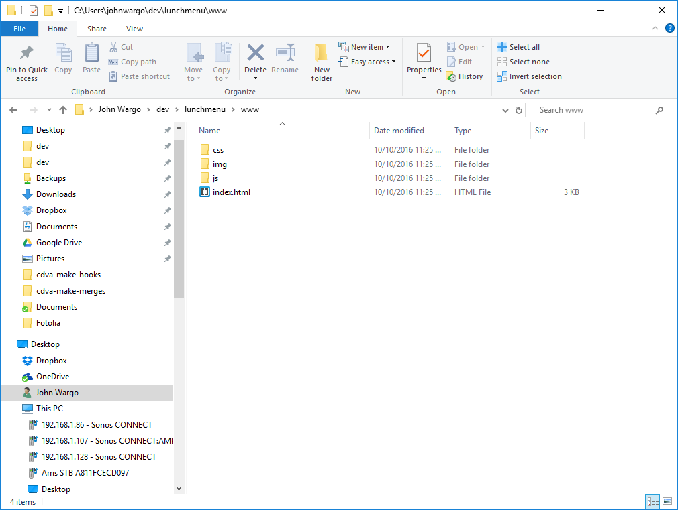
Cordova App Project

Slide 37
The Perceived Problems With Hybrid Development

Slide 38
Hybrid Problems
The WebView is too slow (it was)
You can’t have a native looking UI in a hybrid app (not true)
You can’t have native controls in a hybrid app (not true, stay tuned)

Slide 39
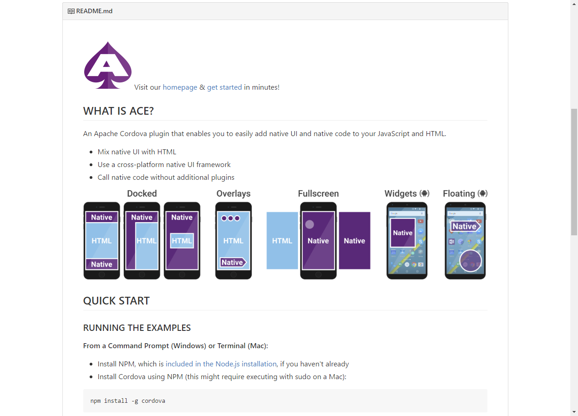
Cordova ACE

Slide 40
The Evolution Of Hybrid

Slide 41
Hybrid Evolves
For years, developers have wanted something better than Cordova
Cross-platform development framework that enables them to craft an app for multiple platforms using a single code base
Something that enables them to use their web development skills to build native mobile apps
Something that enables them to have access to native mobile APIs
Something that enables them to build native UIs using web technologies

Slide 42
Open Source, Cross-Platform Mobile Development

Slide 43
JavaScript-Driven Native Apps
Native mobile apps
Native app UI
Coded entirely, or almost entirely, in JavaScript
Don’t rely upon WebViews to display content
Reasonable % of code reusable across platforms (well, sort-of)
Multiple options available to developers
Released under open source license; most are ‘free, but’ frameworks

Slide 44
Appcelerator Titanium
Oldest tool in the JavaScript-driven native toolbox
Has wallowed under a multitude of ‘free’ options since 2009
Commercial product, community edition available at www.appcelerator.org
Code business logic and UI in JavaScript
Abstract away UI code through Alloy MVC framework
Can display content in a WebView if you want
Delivers native apps with native UI performance
Offers their own IDE through Eclipse fork Aptana
Appcelerator really just wants to sell you their mobile development platform

Slide 45
React Native
Facebook’s plan to deliver a more consistent interface for, well, Facebook
Open source project led by Facebook, supported by the community
https://facebook.github.io/react-native/
Limited code re-use
Separate UI APIs for Android vs. iOS
No strings attached, Facebook isn’t trying to sell you anything

Slide 46
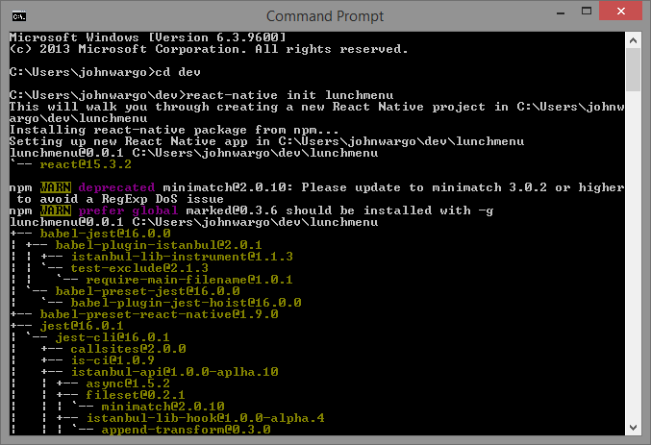
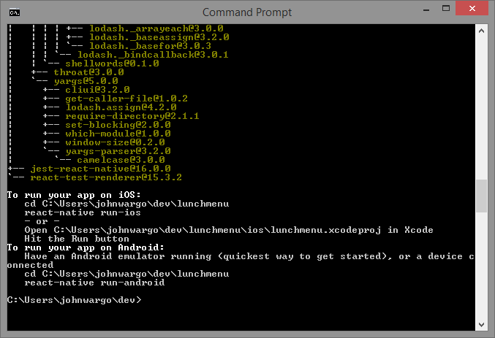
React Native Example

Slide 47
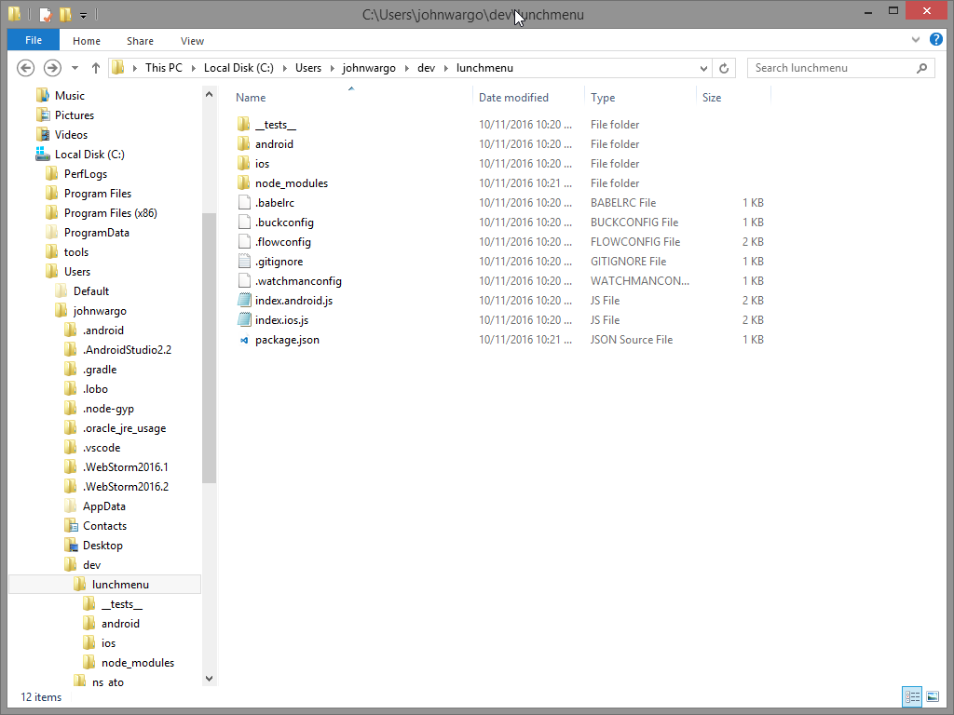
React Native Example

Slide 48
React Native Example
Lets look at some code

Slide 49
NativeScript
Open source framework from Telerik, available from www.nativescript.org
Code in pure JavaScript or use TypeScript & Angular
JavaScript interface to native APIs (UI and other functionality)
Claims a high % of code reuse
Free, free, totally free!
But, Telerik really just wants to sell you their mobile development platform

Slide 50
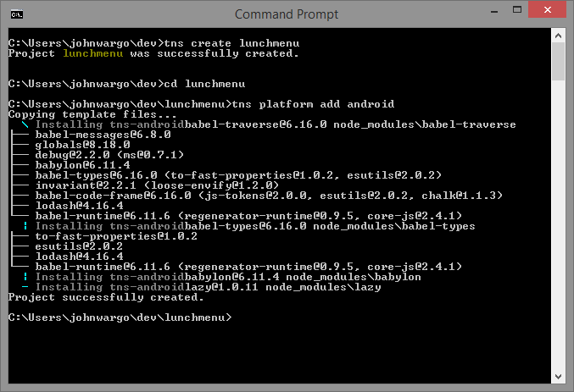
NativeScript Example

Slide 51
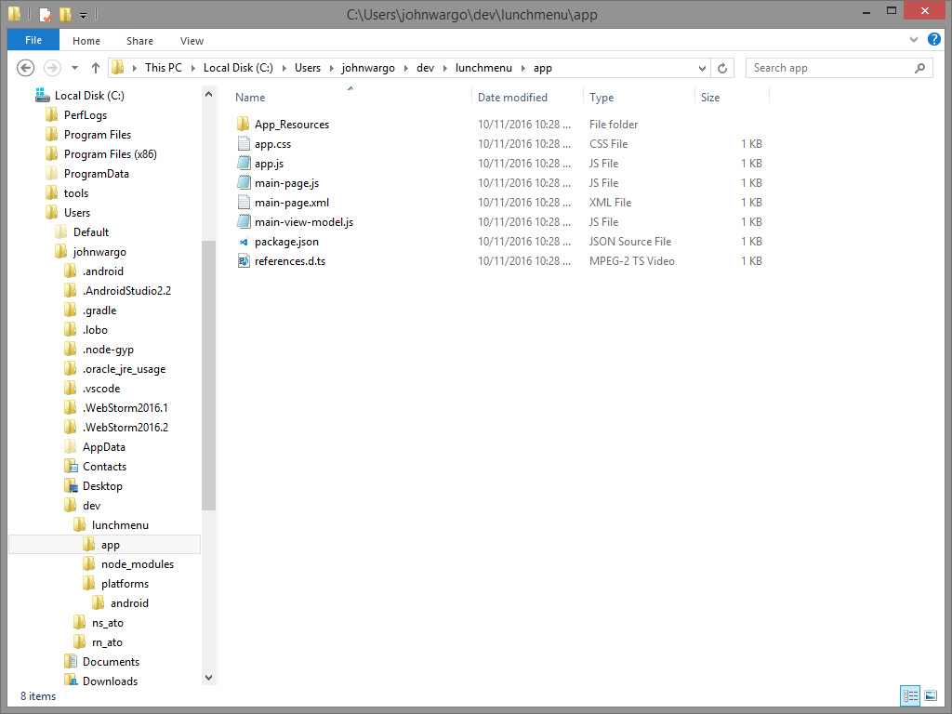
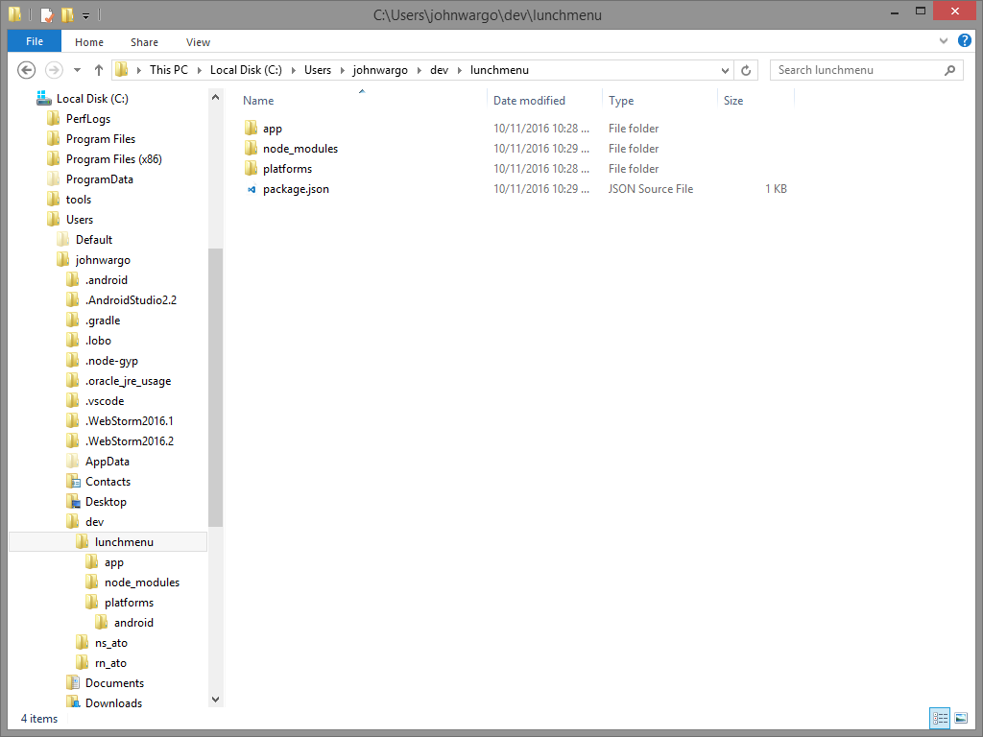
NativeScript Example

Slide 52
NativeScript Example
Lets look at some code

Slide 53
Tabris.JS
Native UI extension for Apache Cordova
Implemented as Cordova plugins you add to your project to expose the native UI (similar to Cordova ACE)
Available at https://tabrisjs.com
Basically exposes a set of native UI components through a JavaScript bridge
No tooling (CLI or IDE for example) but there is a cloud build service
Free, free, totally free!

Slide 54
Summary
Lots of options available to leverage your existing web development skills (well, OK, JavaScript and CSS skills) to build native mobile applications.

Slide 55
Adjacent Native Apps
Native mobile applications, but not written in the native tongue
There used to be two options:
Xamarin
RoboVM

Slide 56
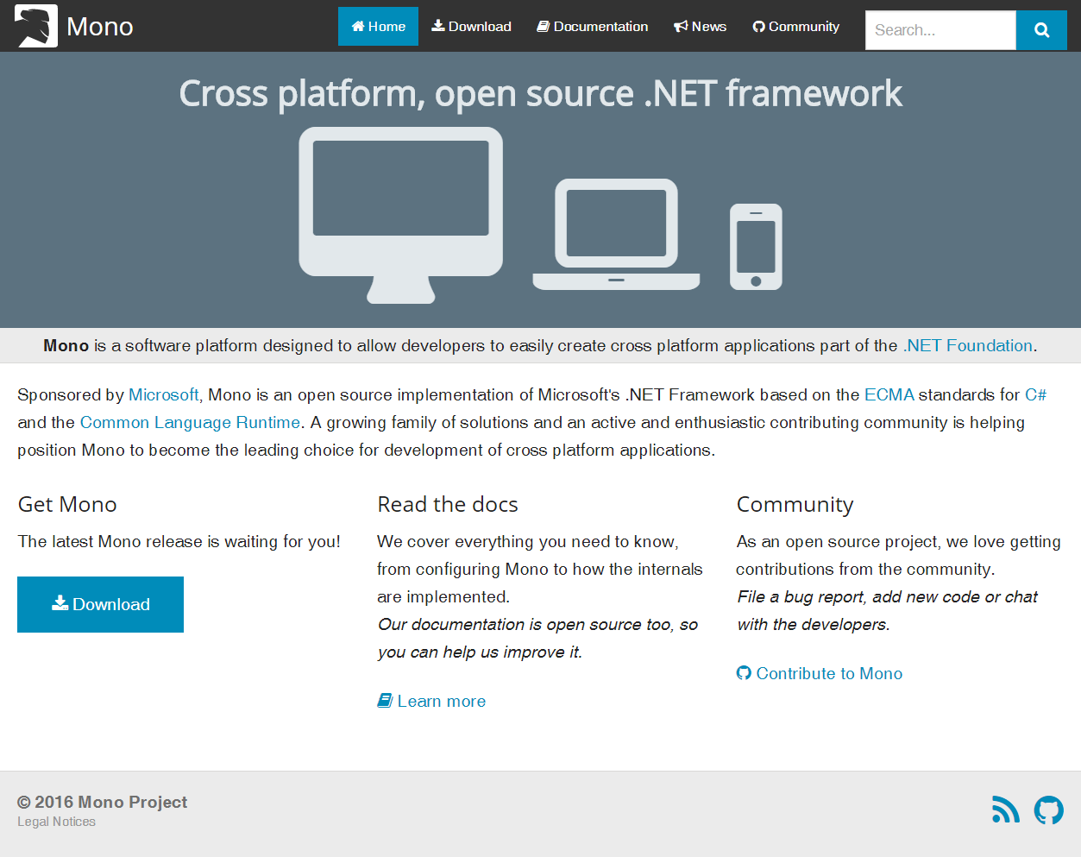
Xamarin
Ever heard of Mono?

Slide 57
Adjacent Native History
Founders of Mono split from Novell, create Xamarin
Xamarin creates commercial offering designed to simplify mobile development
Customers reluctant to buy because of newness of concept (and company)
Xamarin buys RoboVM
Microsoft buys Xamarin
Xamarin kills RoboVM
Xamarin converts RoboVM development team to Xamarin development
Microsoft open sources everything
Free, free, totally free
Microsoft even bundles Xamarin to Visual Studio Community Edition

Slide 58
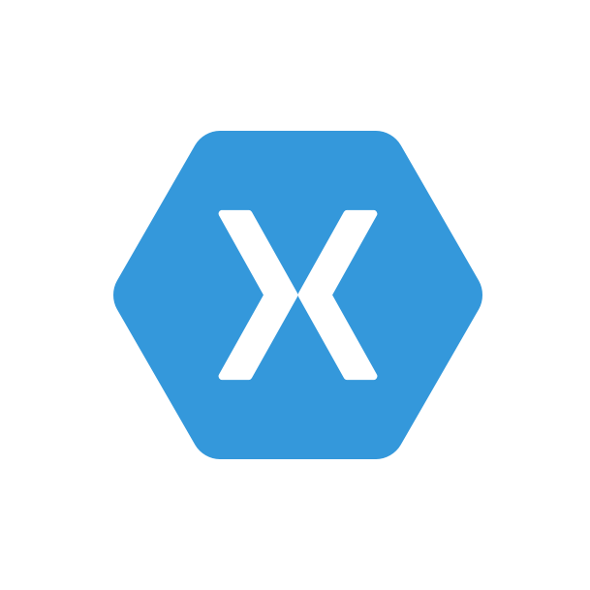
Adjacent Native
Code your app in C#
During compilation, magic happens and out spits a native mobile application
Native app, native performance, native UI
Claims 75% code reuse, independent testing says much, much less
Can abstract cross-platform UI away using Xamarin Forms
Supports
Android
iOS
Windows

Slide 59

Questions?
John M. Wargo @johnwargo www.johnwargo.com

